Slide 1
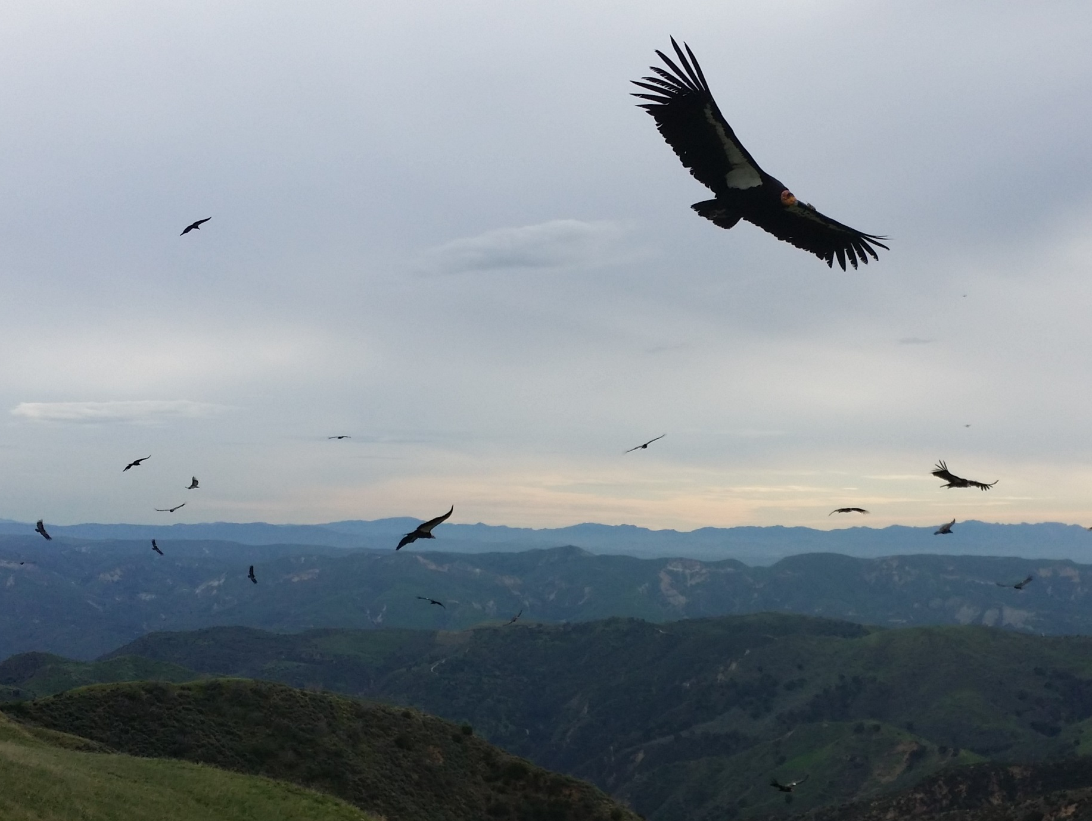
Hopper Mountain National Wildlife Refuge
Daniel Cook, US Fish and Wildlife Service Park Ranger
Notes:
Short introduction to me and USFWS
“…and I work with *** California condors…” ***change slide***

Slide 2
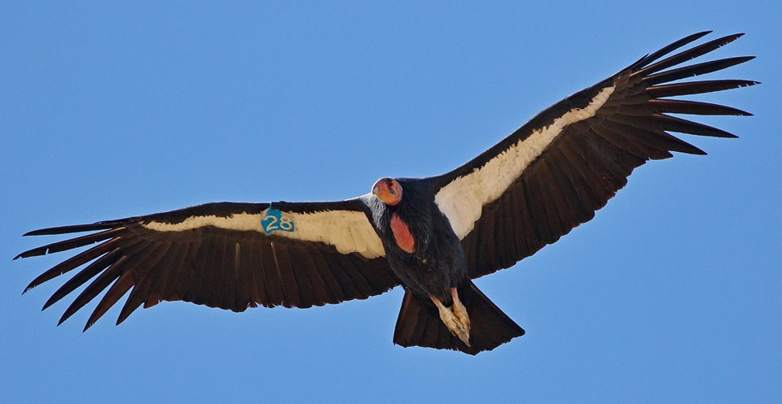
CALIFORNIA
CONDOR
Notes:
Pause and wait (5 – 10 seconds). Allow students to get fascinated, but don’t start answering questions…”We will find out…” ***next slide quickly

Slide 3
Notes:
“You all learned that the California condor’s population crashed in the 1980s.” ***next slide
Background info:
Since the early 1900s the wild condor population was in decline and reached its lowest point in 1983 of 22 condors.
1987 All condors are removed from the wild and the total population is 27.

Slide 4
Notes:
“…and you saw that the population has been coming back since the 90s…this is thanks to the ESA and the California condor Recovery Program.***
Condor began breeding in the wild in 2001. The number of wild fledged chicks has also steadily increased now making up about 20% of the wild population. In recent years some of these wild fledged chicks have now reached breeding age and are producing chicks of there own.

Slide 5
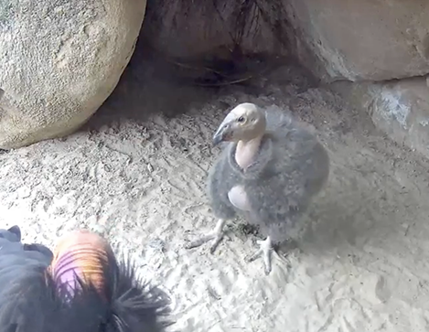
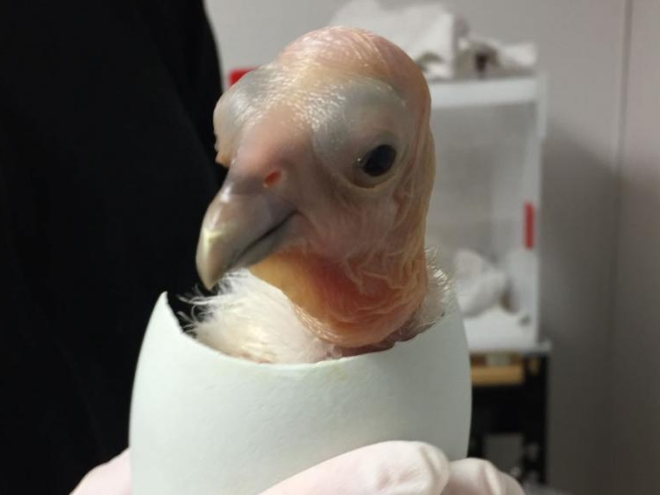
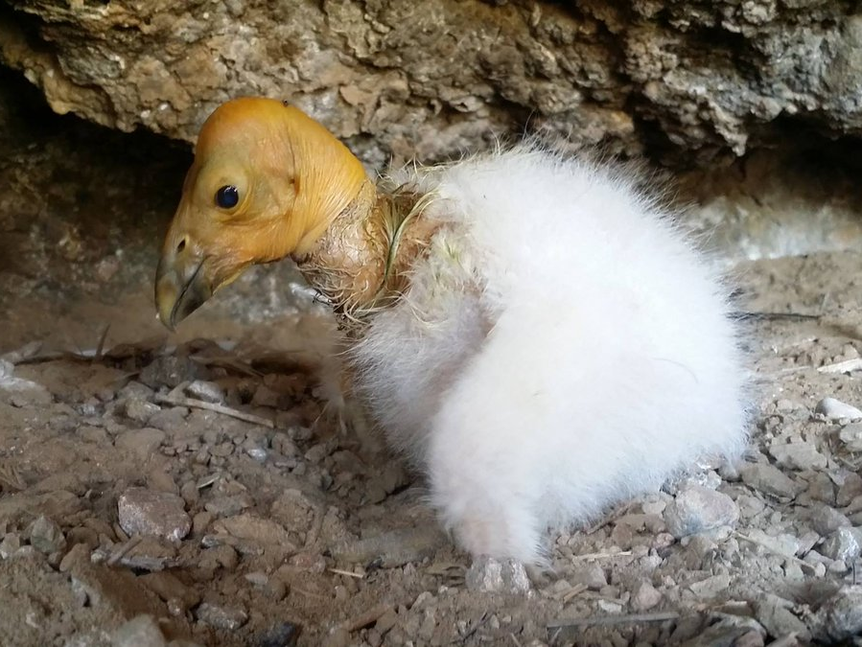
Notes:
The CACO Recover Program has been breeding, (click) rearing (click), and monitoring condors for over 30 years. And I work with them here in Fillmore, at the Hopper Mountain National Wildlife Refuge! The Refuge was established to save condors, but a lot of other species live there too***

Slide 6
Food Web Consumer Research
Species Name: Coyote (Canine latrans)
What do I eat (prey)?
snakes, mice, insects, fruit, deer, birds, rabbits, carrion
What eats me (predators)?
Mountain lion, black bear, coyote, scavengers
When a pup: eagles, dogs
Photo of your Consumer

Slide 7
Objectives:
We will build and use a model of the Hopper Mountain FOOD WEB to show how humans can influence the natural world
We will see how California condors can benefit humans and the ecosystem
Words to learn: opportunistic scavenger, obligate scavenger, carrion
Notes:
Point out Hopper and its proximity to Fillmore. *click to fade map*
Objectives: Learn hopper food web, species, relationships, and roles. Learn the role CACO plays and its benefits to us and the ecosystem.
Vocab: Consumer: a species that gets its food and energy from another individual. Obligate: describing a scavenger that is unable to hunt for its food. Opportunistic: describes a scavenger that can hunt, but will eat carrion if it is available.

Slide 8
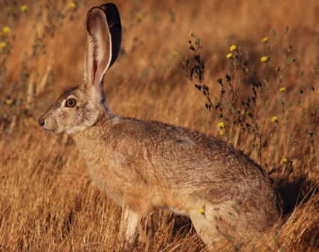
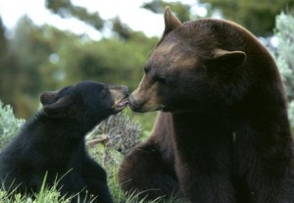
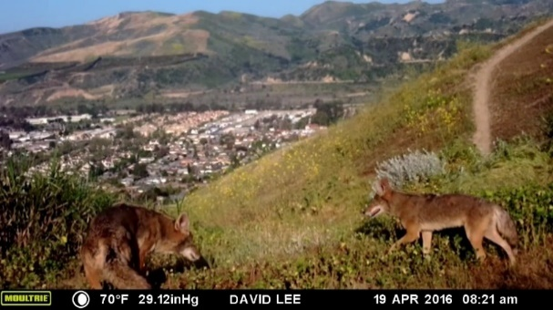
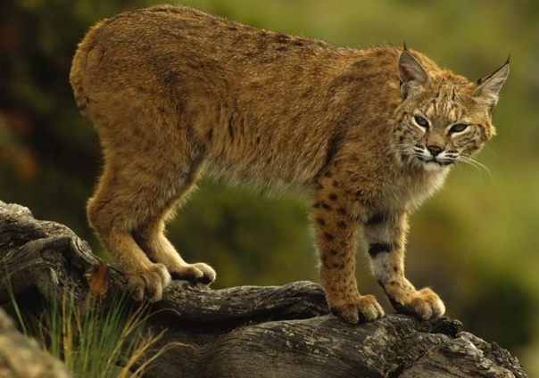
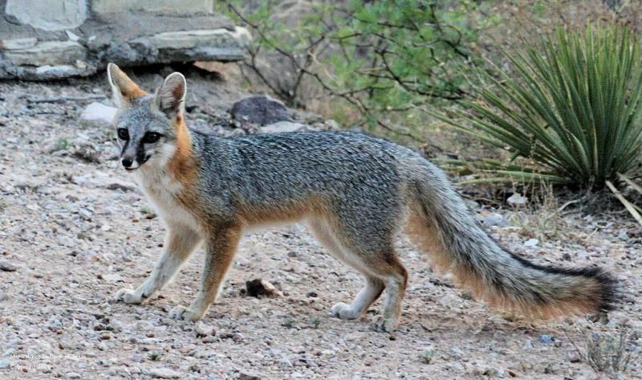
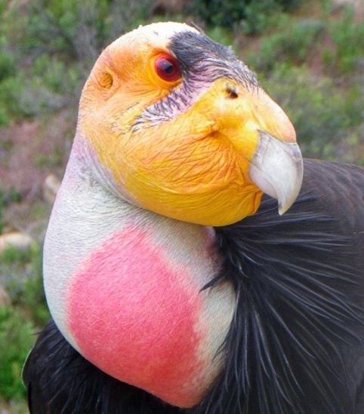
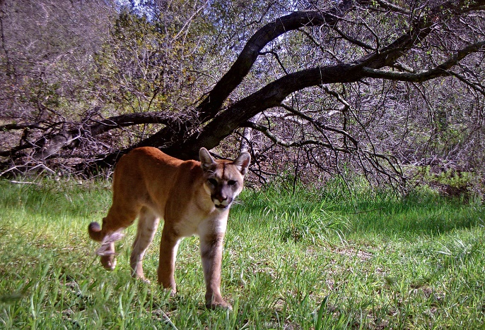
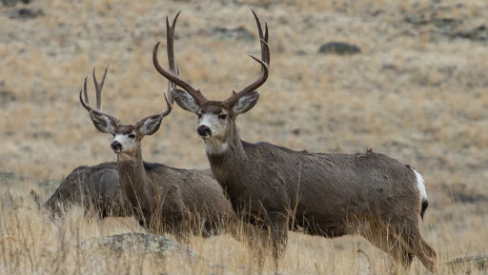
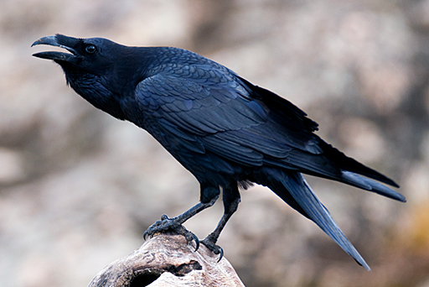
The Hopper Mountain Food Web
- Black bear
- Coyote
- Mule deer
- Grey fox
- Bobcat
- Mountain Lion
- Jackrabbit
- Raven
- California condor
Notes:
Background while students build the food web….10 minutes

Slide 9
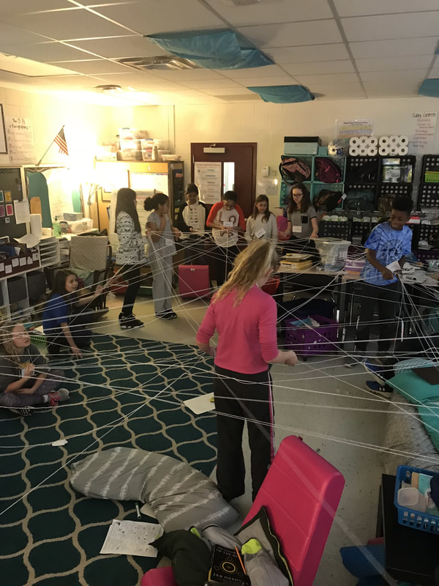
Building Models: A Food Web
Connect your species to all of the food sources it CONSUMES (prey) with the yarn at your desk.
Do you need to include vegetation???
Notes:
Explain that each group will connect THEIR species only to other species which it consumes. Use tape to connect the strings to the photos/biofacts. Do not mention/include the sun and photosynthesis.
***Change the slide once students begin***

Slide 10
The Hopper Mountain Food Web Model
Grey fox
Jackrabbit
Black Bear
Coyote
Bobcat
Vegetation (plants)
Mountain Lion
Raven
Mule Deer
Notes:
Which species is the best predator?
Which species are competing for food sources?
What species are prey
Are humans a part of the food web?

Slide 11
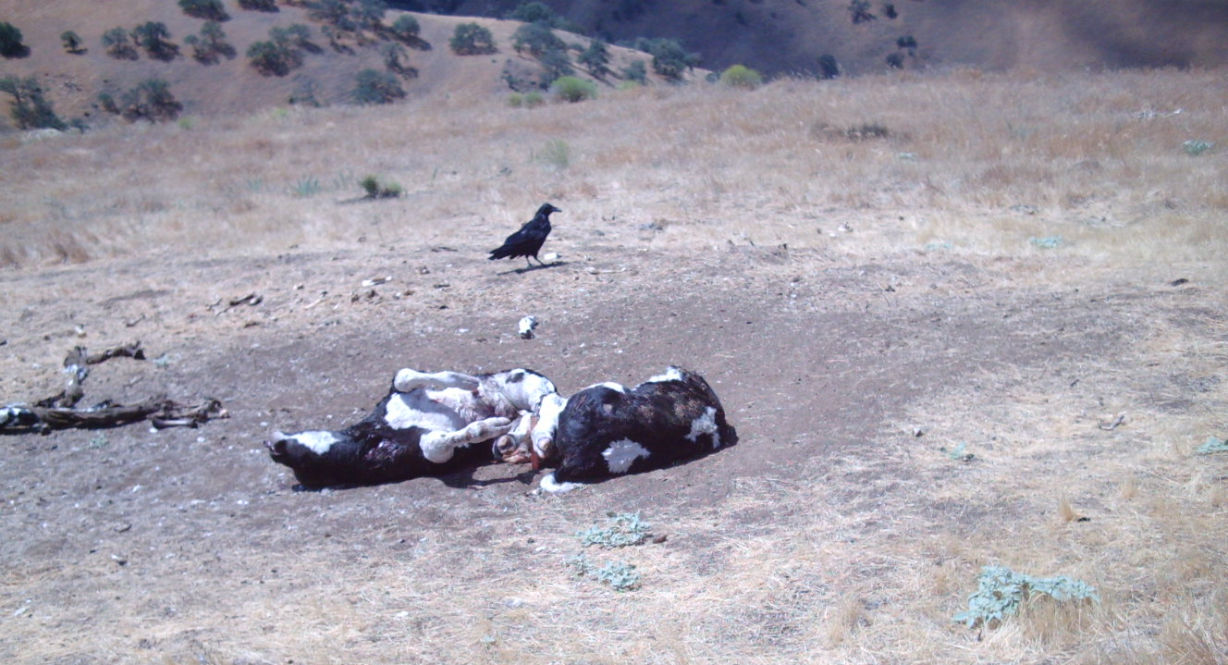
What happens when CONSUMERS die?
What species would eat their carcass?
Notes:
Carcass is a dead animal, also known as carrion…like we see here.
Let students discuss at their desks for 1 minute then share, 1 minute.
“yeah, those are all great…we call those animals that eat carrion SCAVENGERS!!!”***

Slide 12
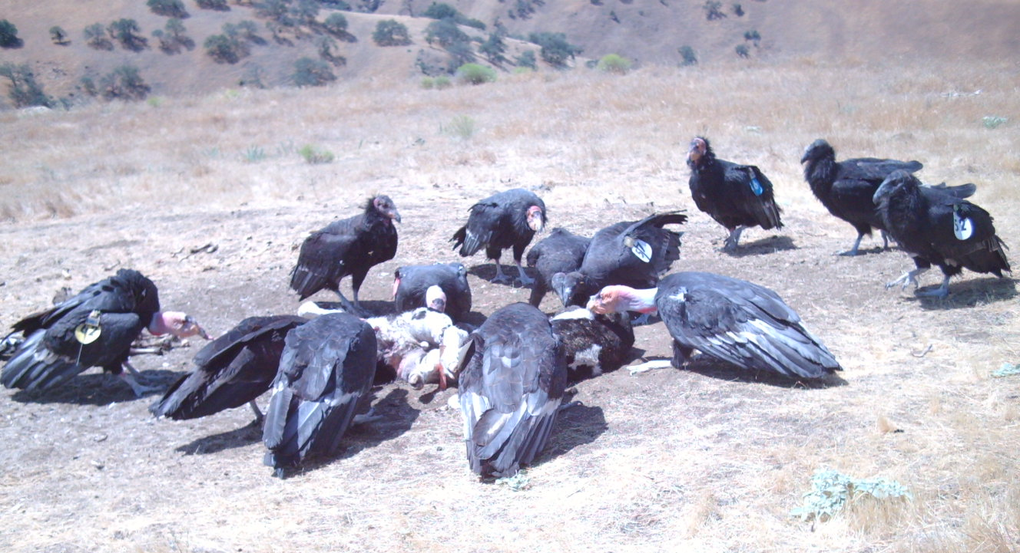
Scavenger: a species that feeds on carrion (dead animals) California condor feeding video
Notes:
A dead animal is also known as a carcass.
California condor feeding video

Slide 13
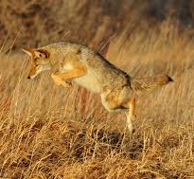
Obligate VS Opportunistic Scavengers
Obligate scavenger: species that are
restricted to feeding on carrion
VS
Opportunistic scavenger: species that
exploit chances offered by immediate circumstances
to feed on carrion
An obligation - I have to VS an opportunity – I could
Notes:
This coyote is obviously hunting. Would coyote eat from a dead deer if coyote found it fresh?

Slide 14
The Hopper Mountain Food Web Model
Grey fox
Jackrabbit
Black Bear
Coyote
Bobcat
Vegetation (plants)
Mountain Lion
Raven
Mule Deer
Notes:
Now we see that the condor is a part of the food web. What is its role?

Slide 15
What’s the point of condors? - What do they do for the environment?
NATURES CLEANUP CREW!
How much rotting meat would be left behind if condors didn’t clean up for us?
Do the Math! ____________________________pounds
Notes:
“What’s the point of condors? – What do they do for the environment?”
Students’ Questions
They remove a lot of carrion from the environment. That carrion could foster diseases and pathogens, and it would stink an awful lot! DO THE MATH!

Slide 16
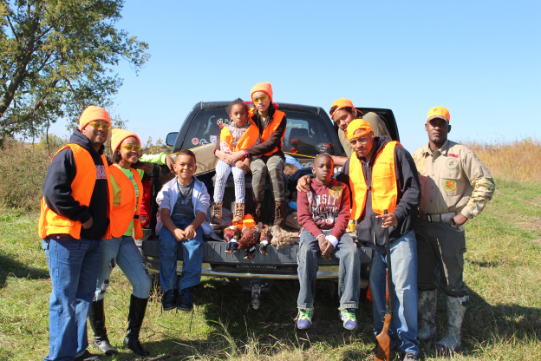
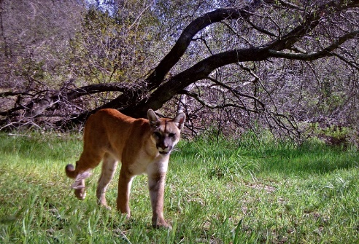
What do you think could happen to the food web if…
1) Humans stopped hunting deer?
2) Humans start eating rabbits instead of chicken?
3) Humans cause a wildfire?
4) Condors go extinct?
Notes:
Background while students build the food web….10 minutes

Slide 17
California Condor Population (2018)
Total World Population: 488
Wild Population 312
California 188
Southern CA 92
Central CA 96
Arizona /Utah 88
Baja, Mexico 36
Captive Population 176
Notes:
2018 numbers. S. CA has 4 chicks (2 fledged) and 13 new releases in 2019.

Slide 18
Find out more…
www.USFWS.gov
The Condor’s Cave on Facebook
Friends of the California Condor Wild and Free
The Condor Spotter.com
www.CondorKids.net

